Slide 1
CapStore Application

Slide 2
Team Members :
Aishwarya Lakshmi Madhira Sai Deepthi Manasa Gundaji Varun Maddineni

Slide 3
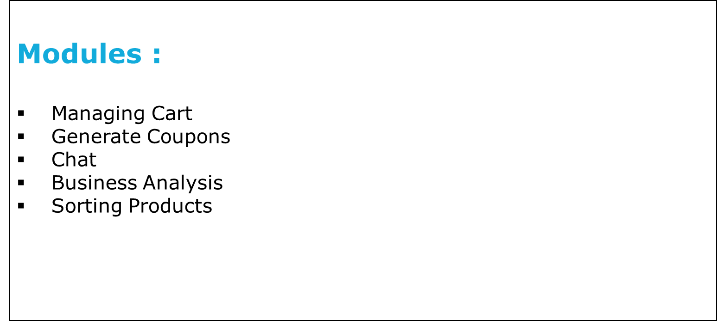

Slide 4
Managing Cart:
Admin should set the minimum cost of purchase.
Customer should be able to add or remove the items from their cart.
Updation of the total amount.
Notes:
Fixar a posicao do titulo – sempre do lado esquerdo.
Sempre que tiver muito texto o coluna deve sempre ser “ narrowed” , se nao fica dificil de ler. Colocar paragrafos no texto.
Linha vertical deve ser mais fina e as pontas NUNCA devem ser arredondadas.

Slide 5
Generate Coupons:
Generate coupons with unique id.
Setting the expiry date for a particular coupon.
Assigning amount for a coupon.
Description of every coupon.
Notes:
Fixar a posicao do titulo – sempre do lado esquerdo.
Sempre que tiver muito texto o coluna deve sempre ser “ narrowed” , se nao fica dificil de ler. Colocar paragrafos no texto.
Linha vertical deve ser mais fina e as pontas NUNCA devem ser arredondadas.

Slide 6
Chat :
3 types of chat boxes will be available, each on customer’s side, merchant’s side and admin’s side.
A customer can interact with a customer representative.
Merchant can interact with the customer representative.
Admin can interact with both merchants as well as customers depending upon their availability. [The availability is decided with the ‘status’ field]

Slide 7
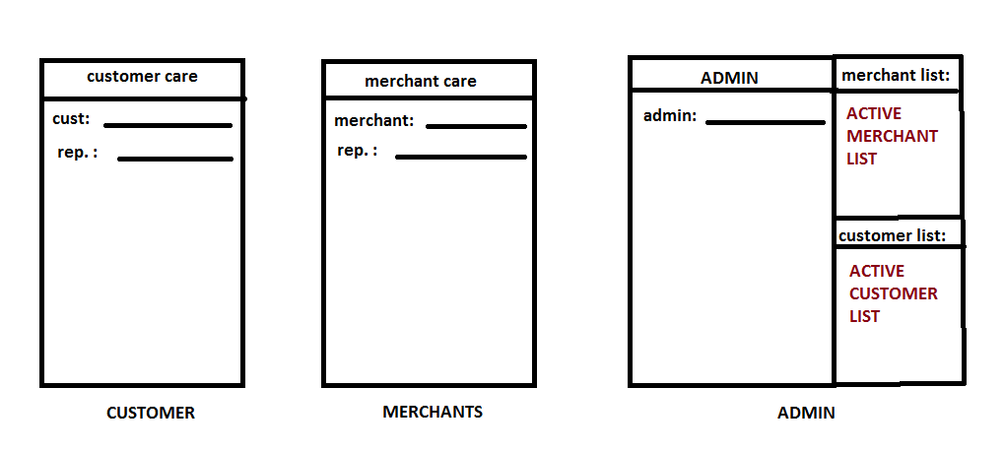
Chat :

Slide 8
Business Analysis :
Generating the analysis statement at the end of day.
Dispatch Report of particular product .
This will be done based on different categories of products, and also for individual products for a particular merchant.

Slide 9
Sorting Products :
Displaying the products by sorting it in ascending or descending order of price.
Displaying the products in a given price range.
Able to view most viewed and best seller products.

Slide 10

Tables Used
Database Handling
Cart
Coupons
Analysis
Contains information of the products present, it’s price, quantity of each product.
Contains Information related to the coupons like coupon code, expiry date, discount amount.
Contains information related to product details, delivery status.
Notes:
Otimo.
Mas eles acham que talvez a forma verde va conflitar se eles mudarem o logo espada para cima do lado direito.

Slide 11
Table 1: Cart
Column_name | Datatype | Constraints | description
Cart_id | int | Primary key
Customer_id | int | Foreign key | Fetch customer details
Inventory_id | Int | Foreign key | Fetch product details
Product_Qty | Int
Price | Int

Slide 12
Table 2: Coupon
Column_name | Datatype | Constraints | description
Coupon_id | int | Primary key | Auto generated
Coupon _code | int |  | Unique alpha numeric code
Description | varchar |  | Explanation about coupon
Coupon_amount | Int
Start_date | date
Expire_date | date

Slide 13
Table 3: Analysis
Column_name | Datatype | Constraints | description
Inventory_id | int | Foreign key | Fetch product id from inventory table
Merchant_id | int | Foreign key | Fetch merchant id from mercahant table
Product_category | varchar
Sales_percentage | double |  | Display the percentage based on sales

